Slide 1
UML Operational Threat & Risk Model Submission Team Formation
July, 2014
OMG Document: sysa/2014-6-17

Slide 2
Status
Threat Modeling project kicked off in Dec 2013
Multi-phase approach
Initially: create Cyber Domain PIM and STIX PSM with UML Profile for NIEM
Expanded to non-cyber domains and inclusion of risk
RFP Draft
RFP Issued June 20th:
http://www.omg.org/cgi-bin/doc.cgi?sysa/2014-6-17
Submission Team
A Submission team has formed and welcomes participation. This submission team is supporting by PM-ISE and the NIEM-PMO
Collaboration GIT site web site (GIT): https://github.com/omg-threat-modeling/phase1
Email: threat@modeldriven.org

Slide 3
OMG Submission Teams
Prepare a submission to the OMG
Most contributors are OMG members, but it is not required
Set our own rules – not governed by OMG
Contributors must sign intellectual property agreement
Reviewers and supporters are welcome
Level of effort up to you (you get out of it what you put in)

Slide 4
High-Level Scope
The critical need identified is federating multiple aspects of operational threats and risks across domains and organizations. Cyber is a critical component, but doesn’t exist in isolation.
Focus on
Operational threats and risks as a Conceptual model in UML
NIEM Mapping
STIX Mapping
Others to follow

Slide 5
Motivation
Multiple communities have developed data and exchange schema and interfaces for sharing information about threats, risks and incidents that impact important government, commercial and personal assets and privacy.
While each of these schema and interfaces provides value for a specific community it is difficult to federate these multiple representations to arrive at broad-based planning, simulation, assessment, situational awareness and forensics, and to then enact the appropriate courses of action. Cyber related attacks have added a new dimension that stresses traditional assessment, monitoring and mitigation strategies.

Slide 6
Scope
This RFP calls for a conceptual model for operational threats and risks that unifies the semantics of and can provide a bridge across multiple threat and risk schema and interfaces. The conceptual model will be informed by high-level concepts as defined by the Cyber domain, existing NIEM domains and other applicable domains, but is not specific to those domains. This will enable combined Cyber, physical, criminal and natural threats and risks to be federated, understood and responded to effectively.
Out of scope for this RFP is non-operational business relevant risk such as marketplace risk, credit risk, legal risk, project management risk, etc.
The conceptual model will have an information exchange format based on NIEM and an explicit mapping to STIX. Other exchange formats, such as CAP may be supported as well.

Slide 7
Clarifying “Operational”
Operational Threat: Operational threats involve specific incidents or groups of incidents that cause unwanted loss or harm to people or important assets or groups of assets. These incidents may be caused by threat actors, accidents or natural phenomenon. Examples include terrorist attacks , hurricanes or an electrical grid failure.
Operational Risk: Operational risks are situations having a negative impact on an organization or company due to uncertainties related to possible breakdowns in a system or its environment via supply chain, injury to a person or failure of a process resulting from intentional/malicious as well as unintentional/natural operational threats. One of the main impacts of operational risks is inability to conduct operations as planned.

Slide 8
Scope Diagram
Wide & shallow conceptual model generically covering threats and risks
Other risks (Out of scope)
Operational Threat & Risk Concepts
High level Cyber-threat/risk concepts
Law Enforcement / Emergency Management Concepts
Physical. Spectrum, facilities,
Probabilities, Forensic, Chemical, Biological, Medical, Nuclear, Military and Intelligence threats concepts
STIX/TAXII/Cybox
IODEF
SACM
ISO
NIST
Others…
NIEM Threat/Risk Representation
Other Risks
Systemic Risk
Credit Risk
Market Risk
Pension Risk
Reputation Risk
Liquidity Risk
Legal Risk
Project Management Risk
Legend
NIEM Exchanges
EDXL / CAP
Others…
Other Inputs
Normative
(Formal Specification)
In Scope with Limited Detail
Informative

Slide 9
Schedule
Milestone | Date
Face-face @ OMG Austin | Sept 15th
LOI Date | January 5th 2015
Initial Submissions due (Feb Meeting) | February 23rd , 2015
Revised Submissions (Sept Meeting) | August 24th, 2015
Final Adoption | Early 2016

Slide 10
Cross-Protocol/Conceptual Model
Benefits
Reduce number of point-to-point interoperability connections; reduce interoperability from N² to linear problem
Enable uniform semantic interoperability
Communities continue driving development of specific threat models
Can support (map between) multiple exchange formats: NIEM, STIX and others
The conceptual model does not commit to any one physical format
Disadvantages
Translations will be lossy
Communities need focus to define mappings from specific model to meta model

Slide 11
Pivoting Through a Conceptual Model
“Source”
Data
Representation
Data representations (Schema & Instances)
Model data for a purpose using a technology
“Instances” are data structures (e.g. SQL tables or XML documents) – “facts” about the things in the world from some perspective
Conceptual Domain Models (CDM)
A conception of the world by a group of stakeholders – less purpose specific
“Instances” are things in the world – so can’t be in models
Using abstraction, we can have multiple representations of facts about the world in different data structures and technologies
Rules define how domain concepts can be represented in a particular form – rules can be simple and generic or heavyweight and specific, depending on the representation.
“Target”
Data
Representation
Represent
Rules
Conceptual Domain Models
(Models of the world)

Slide 12
Cross domain focus
Any
Operational threats and risks
Criminal
threats
Suspicious
Activity
Threat/Risk
Focus
Natural
threats
CAP
Physical
threats
A little extra for Cyber?
STIX/TAXII
Leverages
STIX/Cybox
CYBOX
Cyber Only
Detail

Slide 13
Use Cases
Note that more use case information is on web site

Slide 14
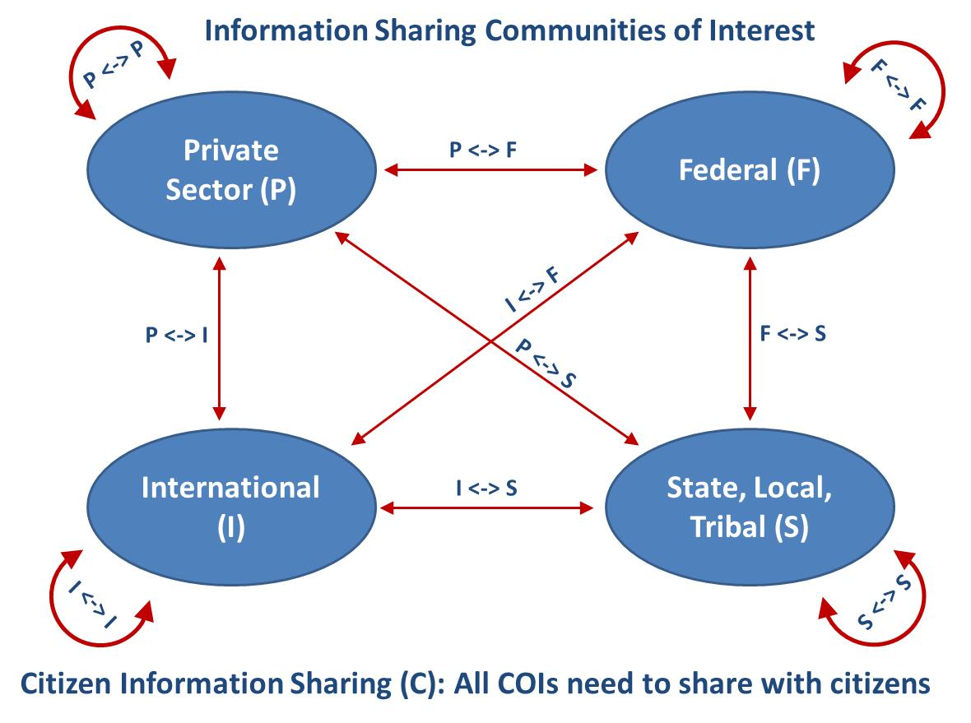
Use Case Taxonomy (Government Perspective)

Slide 15
Use Case Taxonomy
Communities | Description
P <> F | Private Sector to Federal Government
P <> S | Private Sector to State, Local, Tribal Government
P <> I | Private Sector to International Government Partners
F <> S | Federal Government to State, Local, Tribal Governments
F <> I | Federal Government to International Government Partners
S <> I | State, Local, Tribal Government to International Government Partners
P <> P | Within Private Sector
F <> F | Within Federal Government Agencies
S <> S | Within State and local agencies (intra and inter)
I <> I | Among International governments (through bi-lateral or international treaties)
F <> C | Federal Government sharing with Citizen
P <> C | Private Sector sharing with Citizen
S <> C | State Government sharing with Citizen
C <> C | Citizen sharing with Citizen

Slide 16
Example Use Cases
Use Case Category | Use Case | P<>F | P<>S | P<>I | F <>S | F <>I | S <>I | P<>P | F <>F | S <>S | I <>I | F <>C | P<>C | S <>C | C<>C
Enhances Shared Situational Awareness | Configuration/ Anomaly Reporting | X |  |  | X | X |  | X | X | X | X
 | Knowledge of Threat Actors | X |  |  | X | X |  | X | X | X | X
 | Incident Awareness | X |  |  | X | X |  | X | X | X | X
 | Indications & Warning | X |  |  | X | X |  | X | X | X | X
 | Vulnerability Knowledge | X |  |  | X | X |  | X | X | X | X
 | Mitigation Strategies | X |  |  | X | X |  | X | X | X | X
 | Mitigation Actions and Responses | X |  |  | X | X |  | X | X | X | X
Victim Notifications | Victim information compromised as part of a cyber-intrusion |  |  |  | X |  |  |  |  |  |  | X | X | X | X
 | Victim is directly involved in a cyber-enabled crime |  |  |  | X |  |  |  |  |  |  | X | X | X | X
Justice and Public Safety | Cyber Intrusion Sharing |  |  |  | X | X |  |  | X | X
 | Cyber Enabled crimes/ Investigatory Referrals |  |  |  | X | X |  |  | X | X
 | Fusion Center Cross-Domain Sharing |  |  |  | X | X |  |  | X | X

Slide 17
Use Case: Large Company
Company with multiple datacenters, office facilities, international business activity
Large number of deployed security systems, sensors
Firewalls, IDS/IPS, SIEM, monitoring systems, notification/alerting, etc.
Uses FW/Snort rules, STIX/TAXII, IODef, alarms for fire and intrusions, etc.
Physical and information security staff, some 24/7
Interoperable (but not uniform) threat monitoring and assessment

Slide 18
Use Case – Critical Infrastructure
Target: A group of organizations that collaboratively manage critical infrastructure and utilize Industrial Control Systems.
Power, water and other critical infrastructure are threatened by cyber and physical terrorism.
Industrial Control Systems are increasingly computer controlled and connected (directly or indirectly) to the internet and may embed compromised control hardware/software from questionable sources.

Slide 19
Overview of Models
Notional models – what this may look like

Slide 20
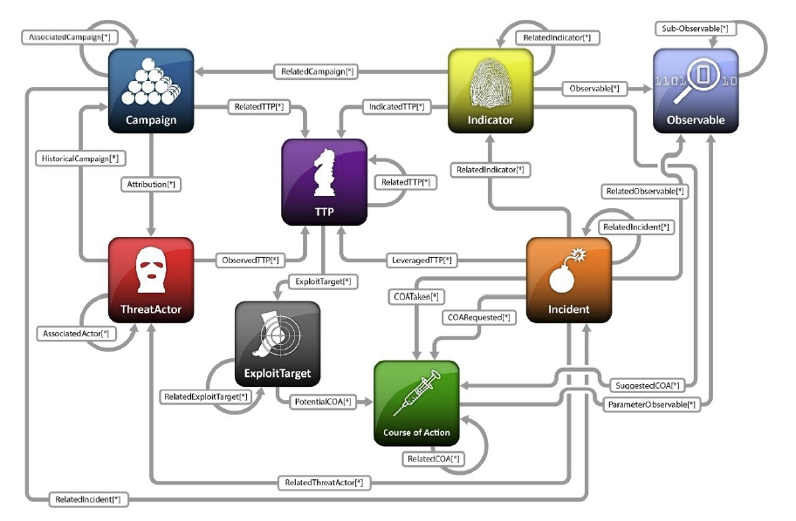
STIX High Level Architecture

Slide 21
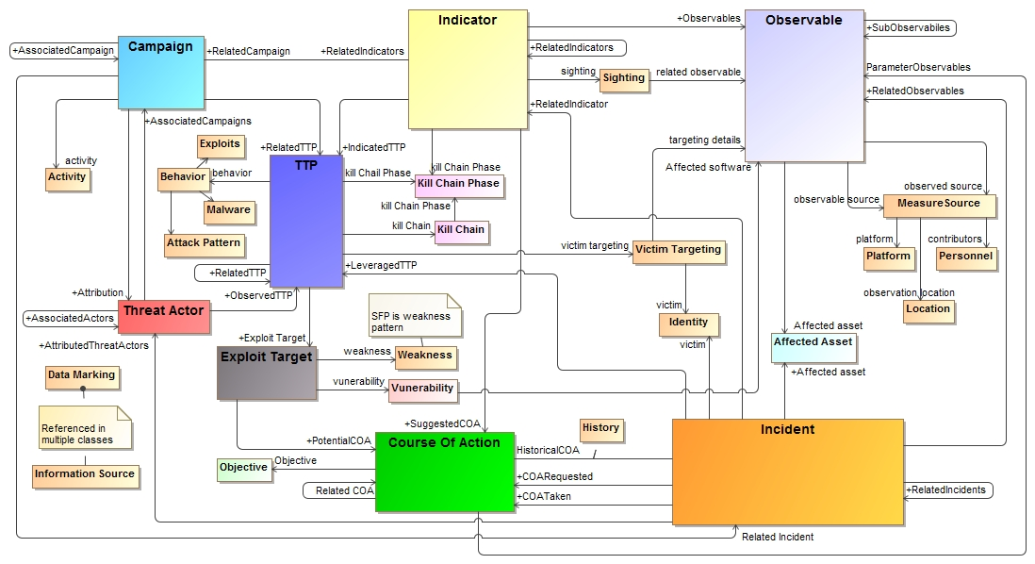
STIX (High Level) in UML

Slide 22
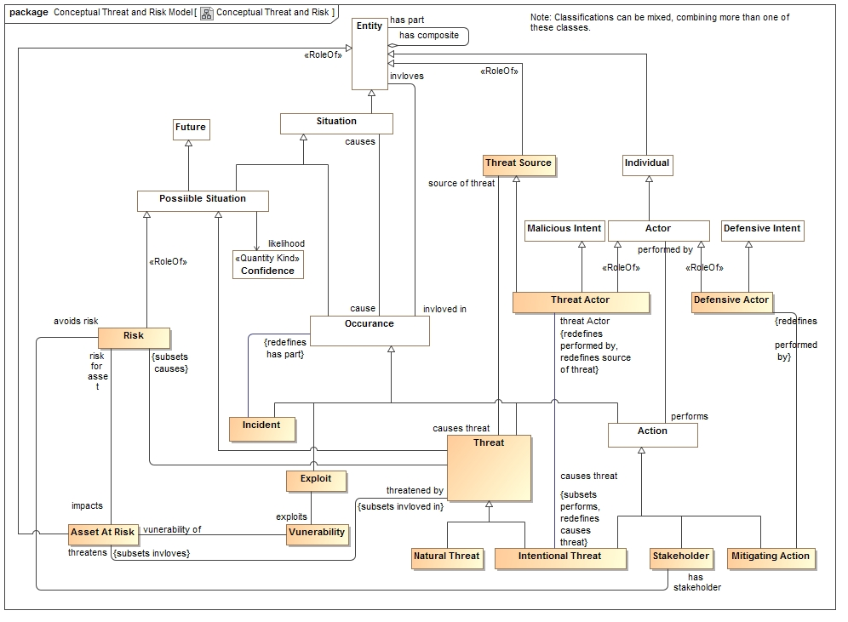
Notional conceptual model

Slide 23
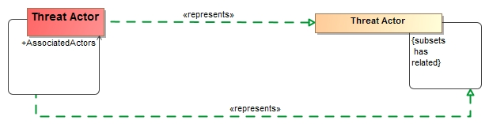
Mapping Example
Note: It will not always be this easy!

Slide 24
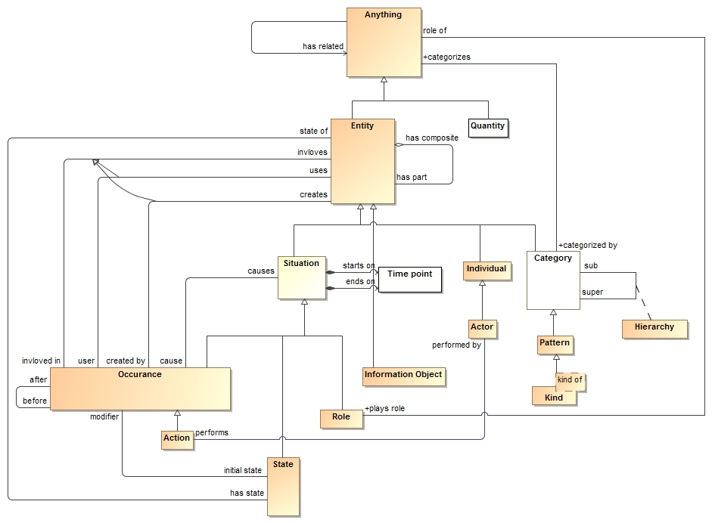
Foundation Concepts
(Vocabulary)

Slide 25
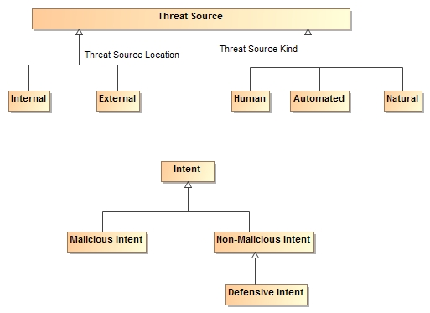
Threat/Risk Foundation Concepts

Slide 26
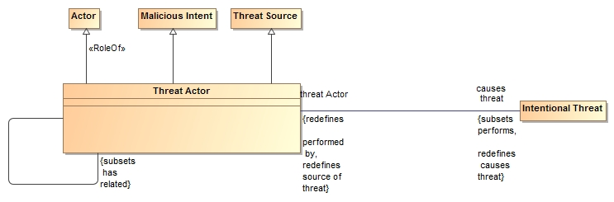
Specific Concepts are Defined In Terms of Foundational Concepts
A threat actor is a role of an actor with malicious intent that is the source of a threat. A threat actor causes an Intentional Threat and may have related threat actors.
Note that completed model will have more properties and associations.

Slide 27
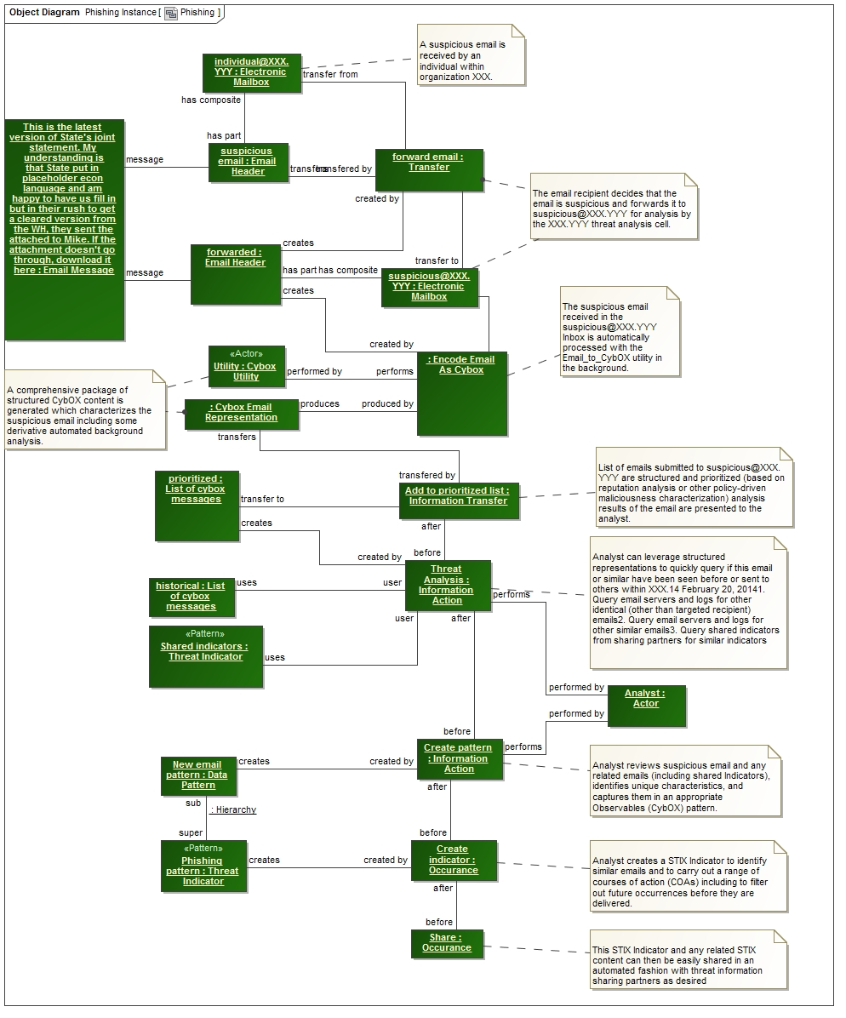
Validation with instances

Slide 28
RFP Requirements

Slide 29
Conceptual Models
Submissions shall define modular UML conceptual models to specify the concepts required to represent information about operational threats and risks.
The conceptual model shall capture the intended meaning of operational threat and risk related concepts such that it may be used as a reference for the use of those concepts in specific exchanges and data stores.
The conceptual model shall not assume any particular technology, domain, representation, structure of information or schema. It shall be a model of the concepts representing real-world entities, not of a specific data representation.

Slide 30
Threat/Risk Concepts To Define
Operational Threat
Operational Risk
Asset
Campaign
Cause
Effect
Exploit target
Goal
Hazard
Impact
Incident
Indicator
Likelihood
Mitigation
Observable
Observation
Observation Metadata
Procedures
Risk
Safeguard
Severity
Strategy
Tactics
Techniques
Threat
Threat actor
Threat source
Undesired event

Slide 31
Classes of Threat/Risks in scope
Cyber/information and communication systems and assets
Physical systems and assets, including embedded and manufacturing
Electromagnetic spectrum assets (E.g. interference with wireless systems or radio)
Industrial control systems

Slide 32
Constraints
Defensive, offensive, or other actors may or may not have insight into the plans or strategies of the respective other actors. As such, model implementations will in those cases be incomplete and rely on estimates and assumed parameters.
Models must be able to support non-actor threats (such as natural disasters ) that will not be associated with any coherent intentions or plans.
Bystanders and inadvertent actors may perform actions that result in behavior that provides benefits to any other actor (offensive or defensive). Such actions are understood to be non-intentional.
The focus of risks will be those that go beyond the normal course of business and expose the enterprise to increased risk due to threats & vulnerabilities.
Unclear what level of behavioural modeling you have in mind, but in general it could be expected that an offensive actor would have an understanding of the plans of defensive actors [Done-CBC (Also MH)]
6.5.2.5 Models for operational threats and risks shall include concepts for expressing probability and/or confidence levels (e.g. for likelihood of occurrence and impact)
The conceptual model shall include concepts for understanding, planning for and treating operational risks, threats and their contingencies at the governmental and enterprise level.

Slide 33
NIEM Representation & Mapping
Submissions shall define a normative NIEM-UML PIM representation sufficient to capture the concepts as defined in the conceptual models as defined above.
This NIEM-UML representation shall be mapped to the conceptual models such that the meaning of each threat/risk relevant NIEM element is described in the conceptual model.
The mapping shall be sufficiently expressive such that any set of instances represented in or logically mapped to the conceptual model shall be able to be represented in NIEM (understanding that choices and rules will have to be made).
Any instance of the NIEM specification shall be able to be logically mapped to the conceptual model.

Slide 34
STIX Mapping
Submissions shall define a mapping to the subset of STIX that corresponds with the conceptual model. This mapping shall demonstrate that the conceptual model is sufficient to represent high-level STIX concepts.

Slide 35
Common Requirements
All models shall utilize UML and UML profiles as a foundation.
Concepts that are required for understanding threats or risks should, as much as possible, be defined in a modular fashion such that these concepts may be reused for related threat/risk concepts NIEM and other reference models shall be used as a reference for such cross-domain concepts.

Slide 36
Optional Mappings
Submissions may provide normative or non-normative mappings to support the following Platform Specific Models, or logical models for the following protocols or communities:
OASIS Common Alerting Program & EDXL
Others as deemed important by submitters

Slide 37
Optional support for conceptual modeling and mapping
Submissions may reference and/or define non-normative UML profiles and associated QVT (or other ways to express mapping logic) for conceptual modeling and the mapping.
Submitters are encouraged to follow the progress of and use as appropriate SIMF, ODM, MDMI, semantic web and other efforts to help define conceptual models and mappings.

Slide 38
MOF Representation
Submissions may define A MOF metamodel that utilizes the conceptual model and provides an XMI representation of Operational Threats and Risks.

Slide 39
Optional Integration with UPDM
Submissions may define conceptual integration points with UPDM.

Slide 40
Issues To Discuss
Simulation
Applicability
Design choices

Slide 41
Evaluation Criteria
6.8.1 Situational Awareness
Submissions shall be evaluated based on their ability to support broad-based situational awareness about operational threats and risks and represent appropriate courses of action.
6.8.2 Enterprise planning, assessment and architecture
Submissions shall be evaluated based on their applicability to support the planning and assessment for operational risks, threats and mitigations.
6.8.3 Completeness
Submissions shall be evaluated based on the completeness of the representation of operational threat and risk concepts
6.8.4 Fidelity
Submissions shall be evaluated based on their proof of fidelity with existing operational threat and risk specifications and best practices.
6.8.5 Extensibility
Submissions shall be evaluated based on the ability of their approach to be extended to other domains and more detailed levels of granularity in future efforts.
6.8.6 Fit for purpose as defined by use cases
Submissions shall be evaluated based on their ability to support the use cases referenced in section6.1.4.
6.8.7 Understandability
Submissions shall be evaluated based on the ability of non-technical stakeholders to understand the conceptual models and for technologists to understand the relationship of those models to their technology frameworks and representations.

